Slide 1




Slide 2


OUR GROUP

Slide 3
Originally conceived in 1996 as a division of REPREMAR Shipping to develop maritime and air cargo transportation, REPREMAR Logistics became independent on May 1, 1999. It is currently one of the most recognized companies regionally in the cargo transport service between Asia and the east coast of South America. For this purpose, we continuously invest in computer equipment and software that help highlight and enhance our capabilities.
In an increasingly complex, dynamic, and demanding world, we are convinced of the importance of Information Systems
Who are we?
Repremar Logistics | Repremar Group

Slide 4

Special
Services.
Repremar Logistics | Repremar Group

Slide 5


We ship cargo from suppliers around the globe and deliver it to construction sites anywhere in the world. We handle any type of shipment that may be part of a project, from small LCL shipments and containers to items of enormous weight and dimensions. We have experts in ship chartering, heavy cargo handling, trucking, and project management.
+
Servicios Especiales
Repremar Logistics | Repremar Group

Slide 6
Transport of machinery and special vehicles.
Special
Services.
Special packaging and packings.
Break Bulk cargo operations.
Transport of live animals.
Special Services.
Repremar Logistics | Repremar Group

Slide 7
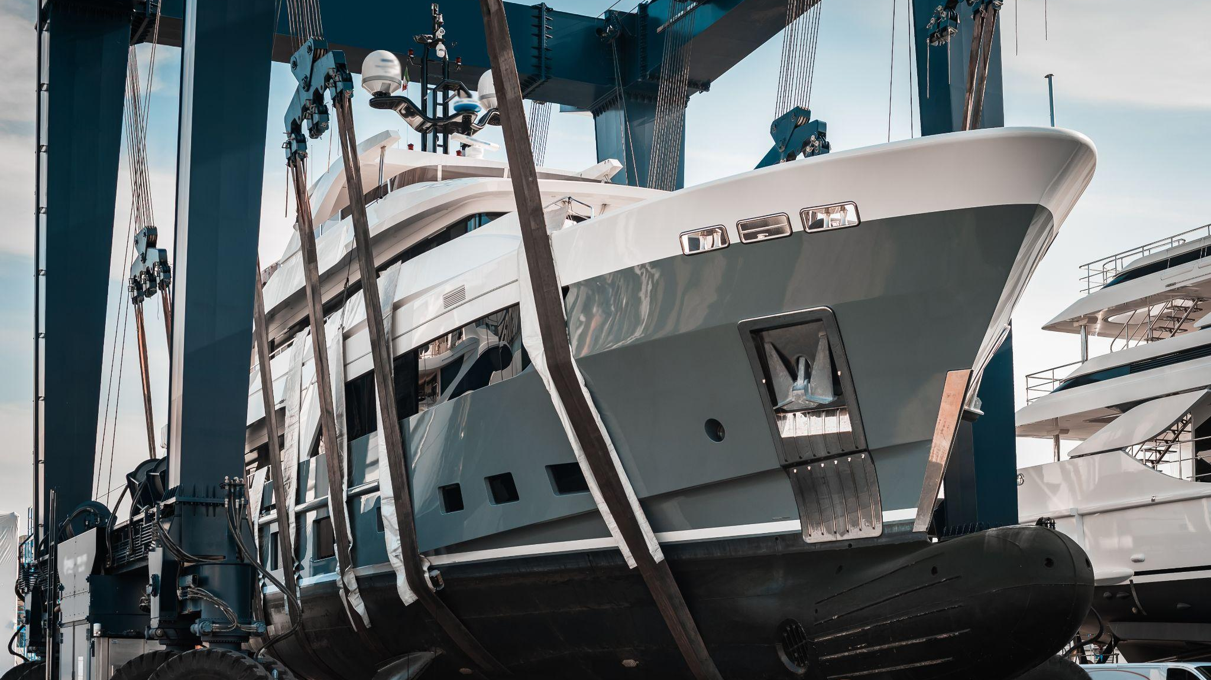
YATCH
TRANSPORT.
Repremar Logistics | Repremar Group

Slide 8
Since 2015, Repremar Logistics has managed the logistics of more than 100 yachts and sailboats with origins/destinations in Europe, Brazil, the United States, and Uruguay. With more than 10 years of experience, we consider this service as one of our pillars regarding project cargoes.
+
Yatch Transport
Repremar Logistics | Repremar Group

Slide 9
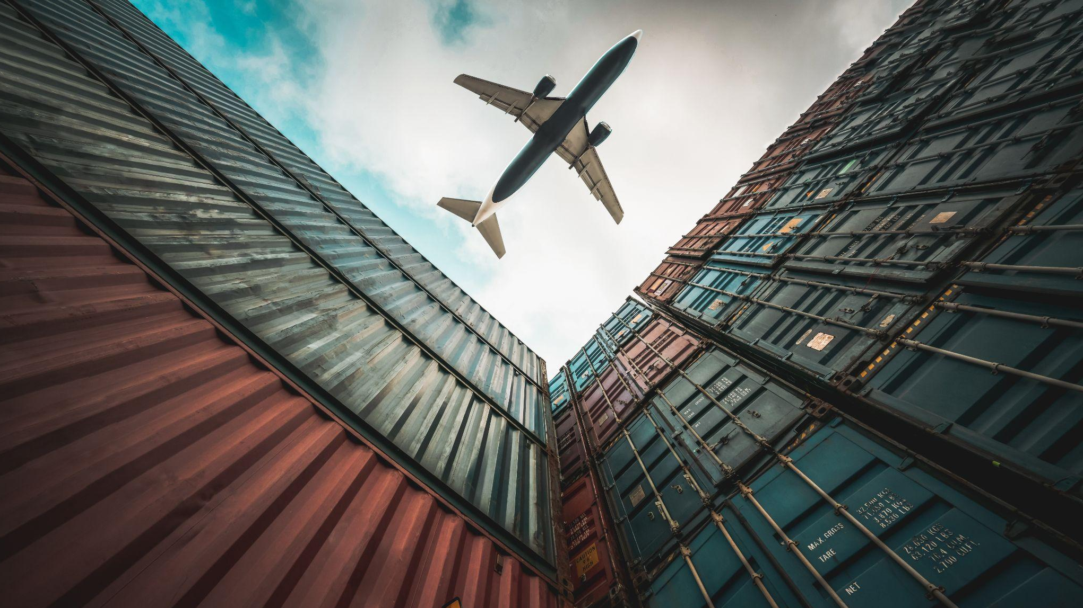
UN PEACE
MISSIONS.
Repremar Logistics | Repremar Group

Slide 10
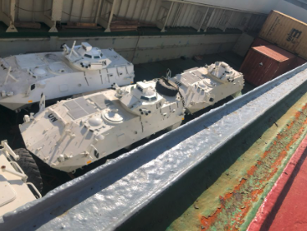
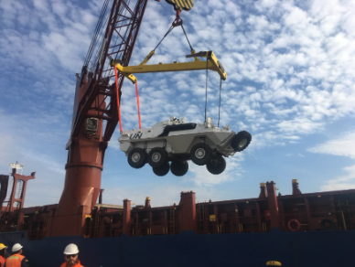
In 2017, 2019, and 2020, we had the opportunity to manage logistics for military vehicles for the collaboration with Paraguayan and Uruguayan armed forces/ UN missions.
UN Missions and army
Repremar Logistics | Repremar Group

Slide 11

HEAVY
MACHINERY.
Repremar Logistics | Repremar Group

Slide 12
We manage the logistics of heavy machinery to deliver anywhere in the world. Together with our trained staff, we have the resources to move any type of machinery, adapting to the needs of our clients.
We have experience in transporting machinery, whether special equipment, tanks, infrastructure, etc.
+
Heavy Machinery
Repremar Logistics | Repremar Group
7

Slide 13
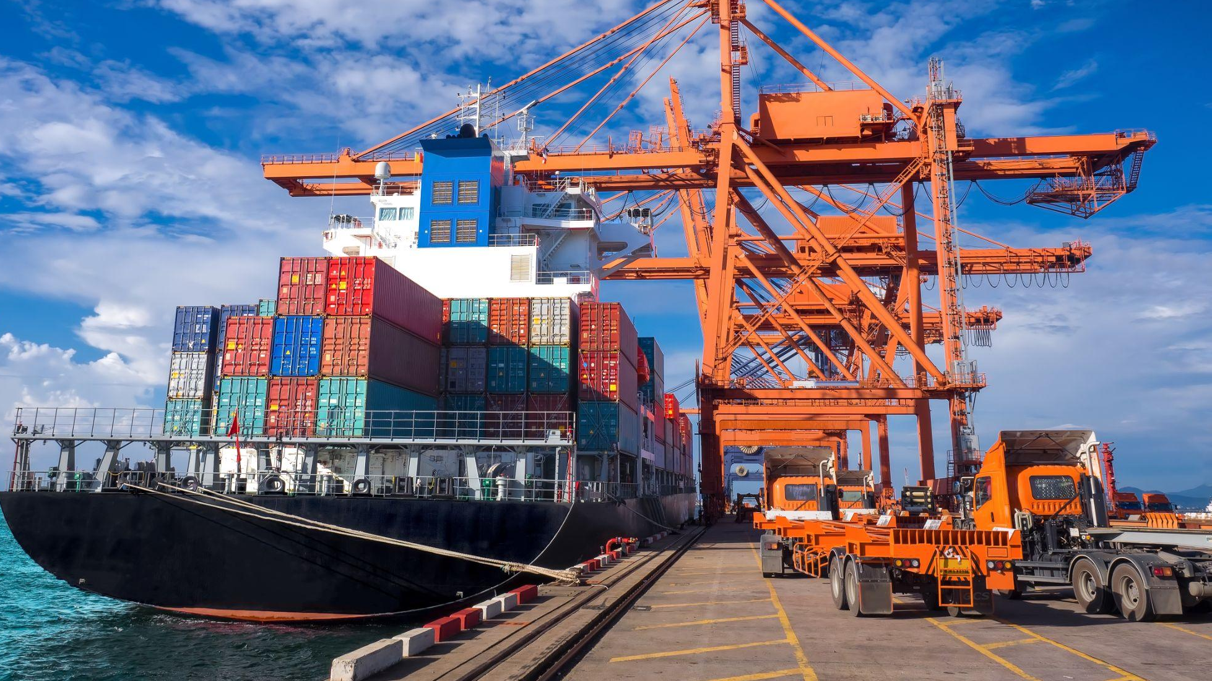
MAQUINARIA
PESADA.
PROJECTS.
Servicios Especiales
Repremar Logistics | Repremar Group
4
Repremar Logistics | Repremar Group

Slide 14
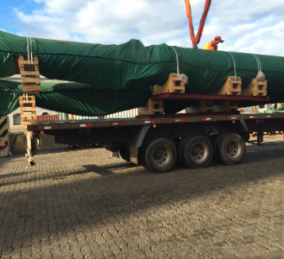
THERMOELECTRIC PLANT,
Vuelta de Obligado, Santa Fe, Argentina
2015 - We managed the logistics of the cooling system of the plant for Torishima in Argentina.
Projects
Repremar Logistics | Repremar Group

Slide 15
CONTINENTAL SHELF
Offshore oil exploration block 14 for Total Energy UY
2016 - For Newpark Drilling Fluids, we managed the logistics of the mud plant and materials that Newpark installed at the port of Montevideo.
Projects
Repremar Logistics | Repremar Group

Slide 16
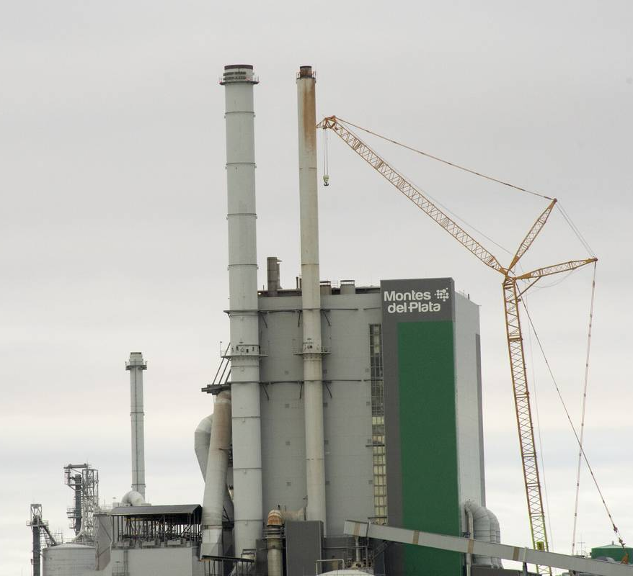
ORIÓN PROJECT
Montes del Plata Pulp Mill in Punta Pereira, Colonia, UY
2011 - 2013 - Logistics of materials for the entire plant for Andritz Pulp and Paper. We moved 11.000 teus and 18 project ships with 110.000 m³.
Projects
Repremar Logistics | Repremar Group

Slide 17
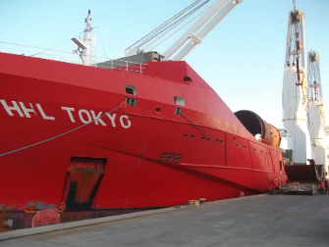
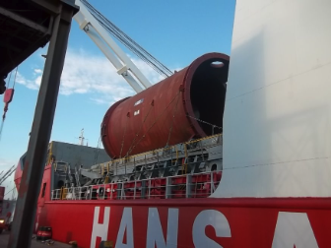
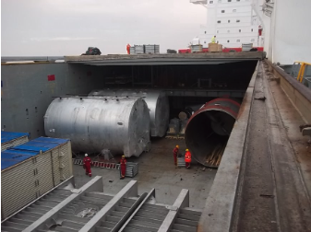
Montes del plata
2011 - 2013
Porjects
Repremar Logistics | Repremar Group

Slide 18
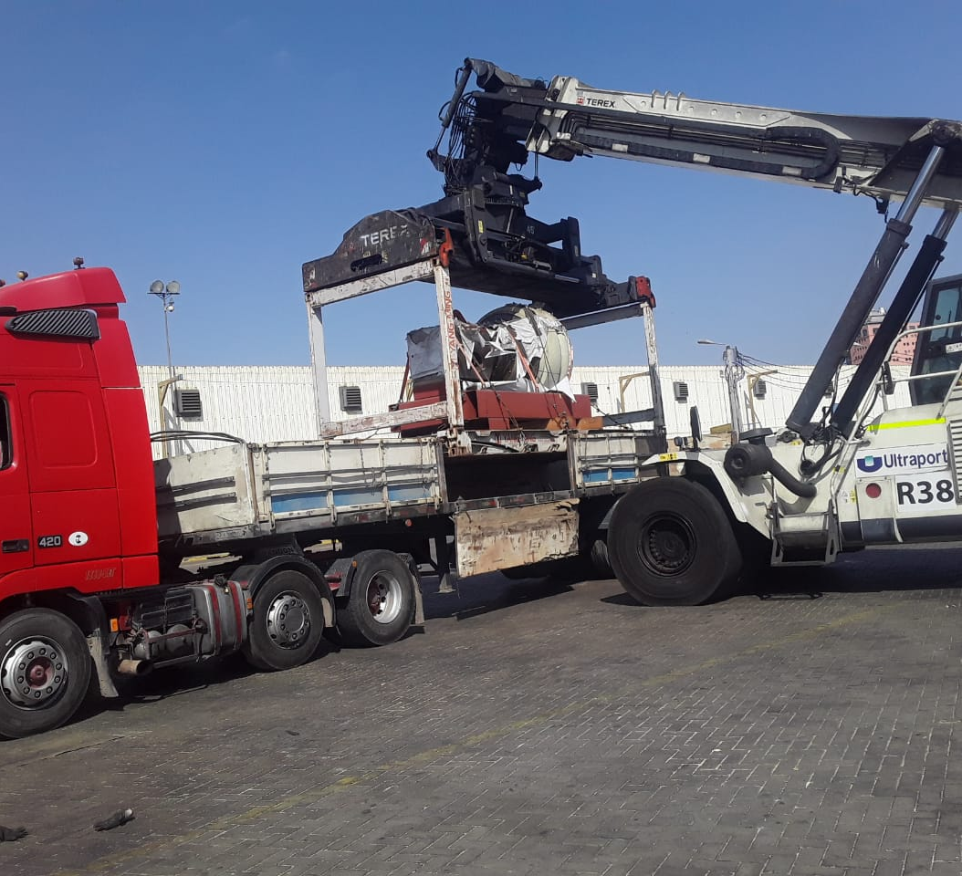
CEMENT COMPANY
Logistics and material handling in
Santa Cruz, BO.
2021 - 2022 - We managed the logistics and handling of all the materials for the plant renovation. This cargo was transported by sea from China to Arica, Chile, and then delivered to Bolivia by land.
Projects
Repremar Logistics | Repremar Group

Slide 19
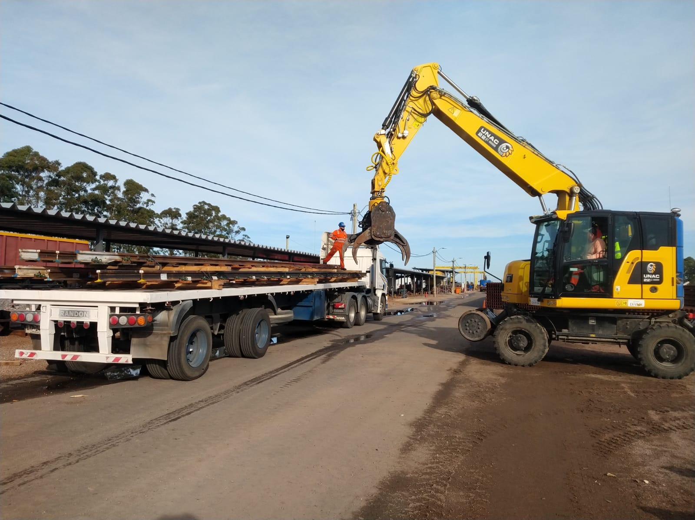
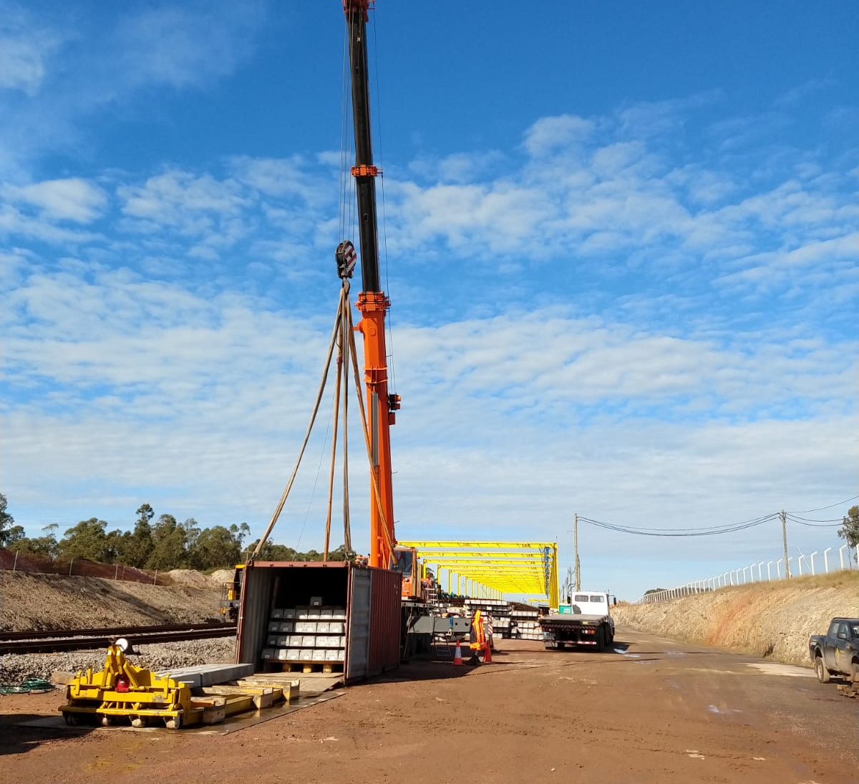
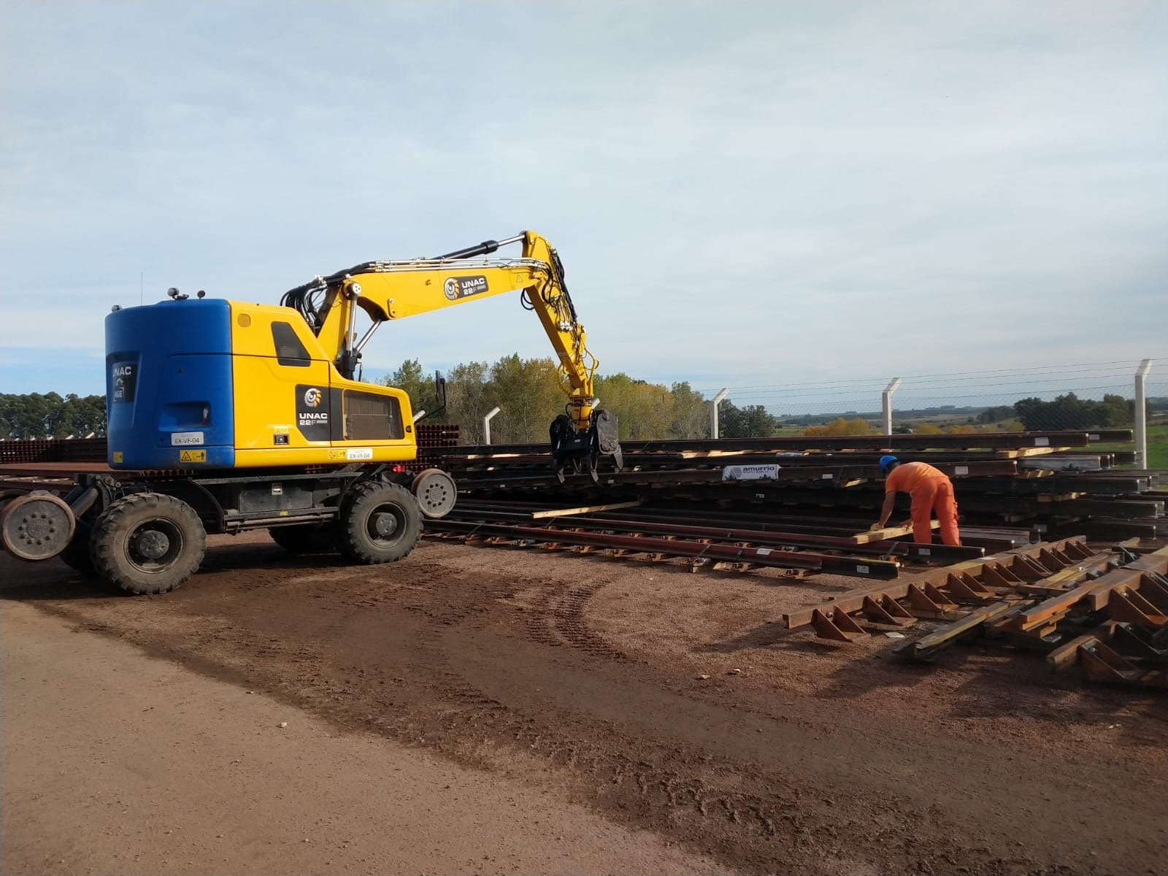
Project
CENTRAL RAILWAY
Projects
Repremar Logistics | Repremar Group

Slide 20
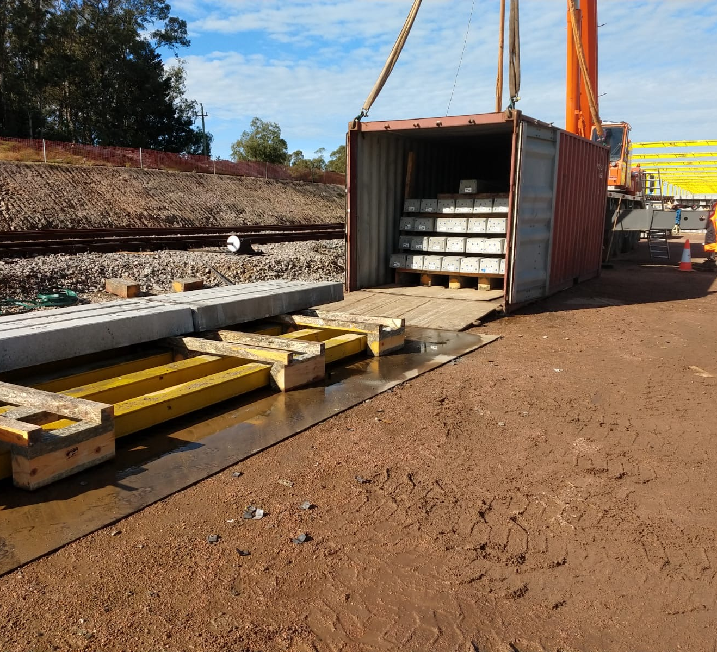
CENTRAL RAILWAY
Grupo Vía Central (consortium Saceem, Berkes, Sacyr, NGE)
Projects
Repremar Logistics | Repremar Group

Slide 21
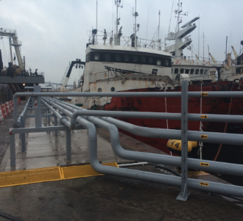
LOCALS
Locally in Uruguay, we have participated in several projects for OSE, logistics of infrastructure for dams, agro and forestry industries.
​
Projects
Repremar Logistics | Repremar Group

Slide 22
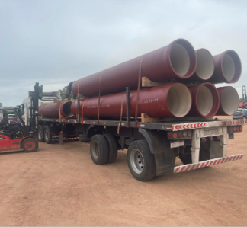
OSE PAYSANDÚ
Transport of pipes for the public water company of Uruguay.
2023 - Transport of pipes for the public water company of Uruguay.
Porjects
Repremar Logistics | Repremar Group

